Slide 1



Coffee shop dashboard
View in Power BI
Last data refresh:
5/16/2026 2:07:57 AM UTC
Downloaded at:
5/16/2026 3:06:13 AM UTC

Slide 2
Overview
Shows coffee shop performance across stores, products, times of day, and categories. It highlights total sales, volume, pricing effects, and peak trading periods while surfacing top and underperforming items and locations. It supports operational and merchandising decisions by revealing demand patterns and mix.

Slide 3
Project Steps
The data was cleaned/prepared using Microsoft excel
After cleaning it was loaded in to SQL for query
Finaly the data was loaded into Power bi for dashboard and report building

Slide 4
Data Preparation Process
Removed unwanted column
Formatted the date column from numbers to short date
Formatted the time column to a proper time column
Formatted the unit price column to currency
Removed duplicates
Created sales and month column

Slide 5
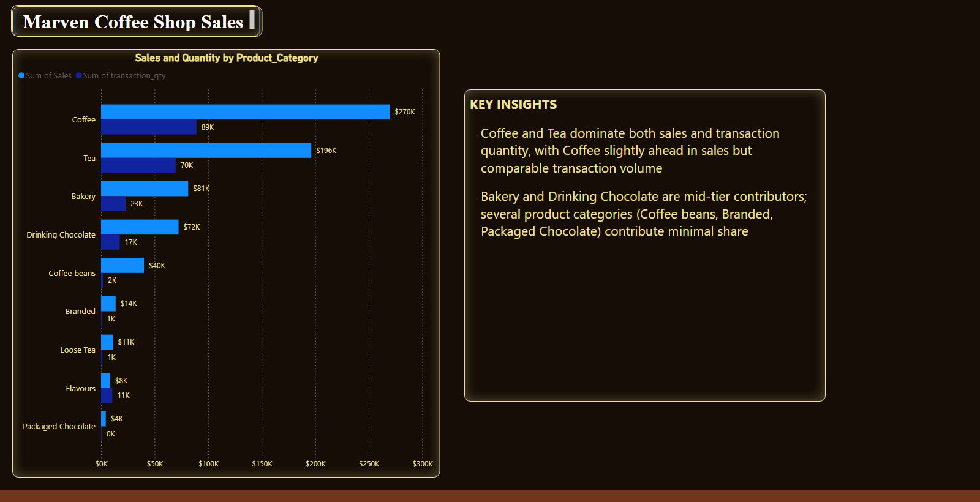
Product Category
Notes:
textbox
No alt text provided
Sales and Quantity by Product_Category
No alt text provided
shape
No alt text provided
textbox
No alt text provided

Slide 6
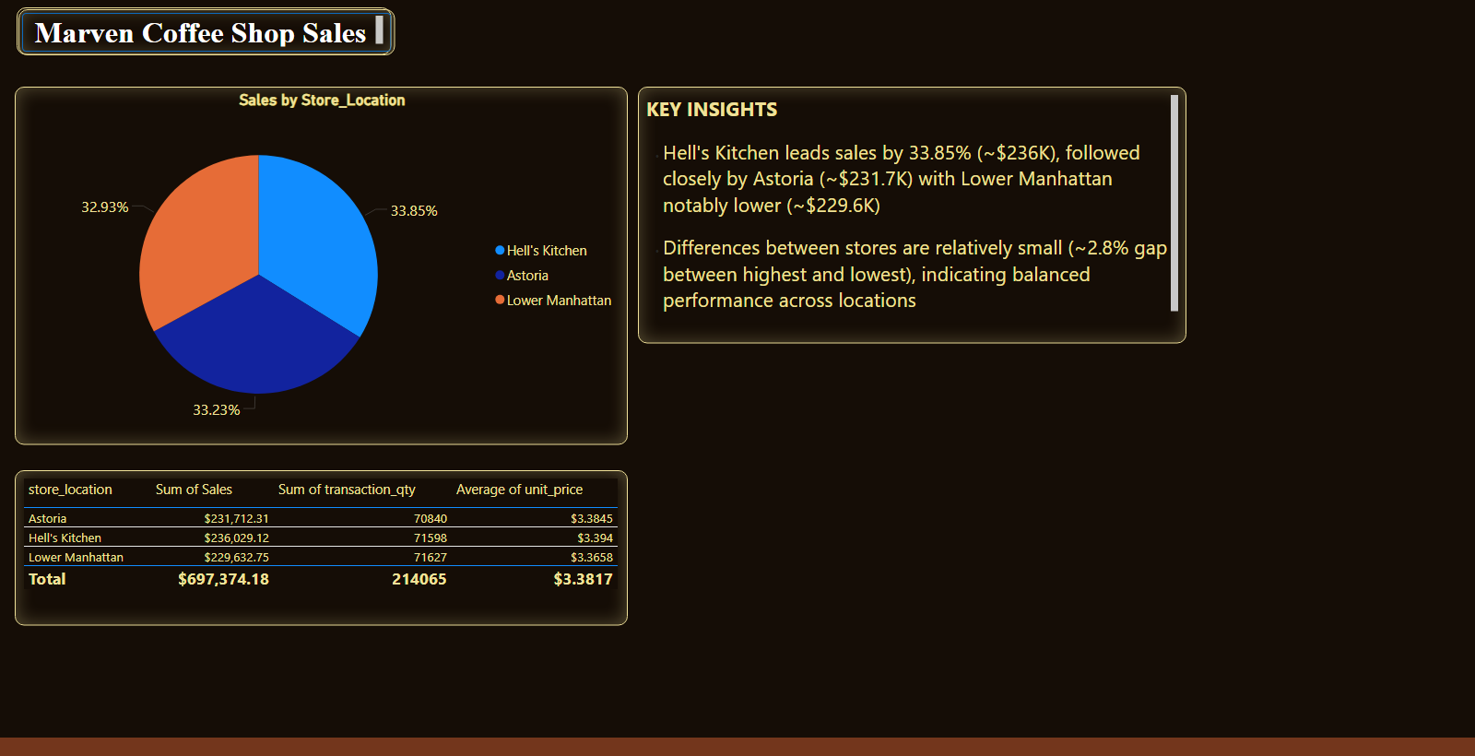
Store location
Notes:
textbox
No alt text provided
shape
No alt text provided
textbox
No alt text provided
Sales by Store_Location
No alt text provided
Store Performance Summary
No alt text provided

Slide 7
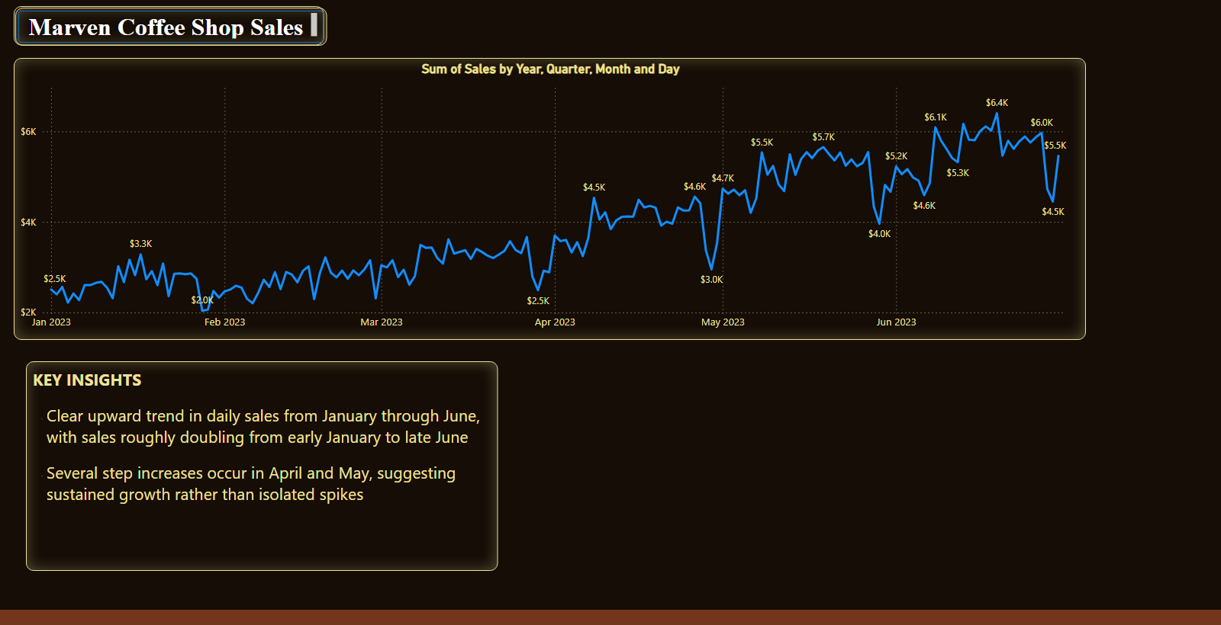
Month on month
Notes:
textbox
No alt text provided
shape
No alt text provided
textbox
No alt text provided
lineChart
No alt text provided

Slide 8
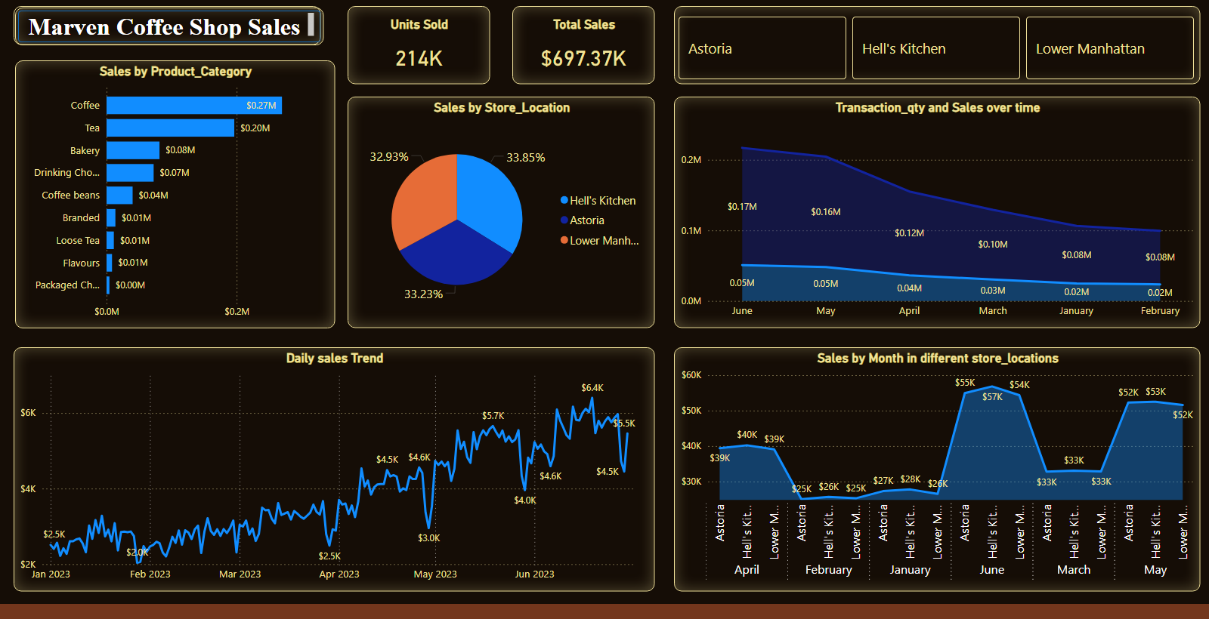
Sales dashboard
Notes:
textbox
No alt text provided
Sales by Product_Category
No alt text provided
Sales by Store_Location
No alt text provided
Total Sales
No alt text provided
Units Sold
No alt text provided
Daily sales Trend
No alt text provided
Transaction_qty and Sales over time
No alt text provided
Sales by Month in different store_locations
No alt text provided
advancedSlicerVisual
No alt text provided
shape
No alt text provided

Slide 9
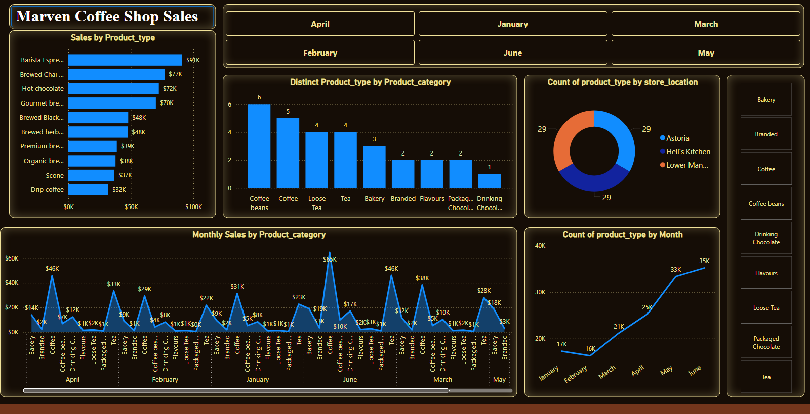
Sales dashboard (product type analysis)
Notes:
textbox
No alt text provided
advancedSlicerVisual
No alt text provided
Monthly Sales by Product_category
No alt text provided
donutChart
No alt text provided
Distinct Product_type by Product_category
No alt text provided
Sales by Product_type
No alt text provided
lineChart
No alt text provided
slicer
No alt text provided
shape
No alt text provided

Slide 10
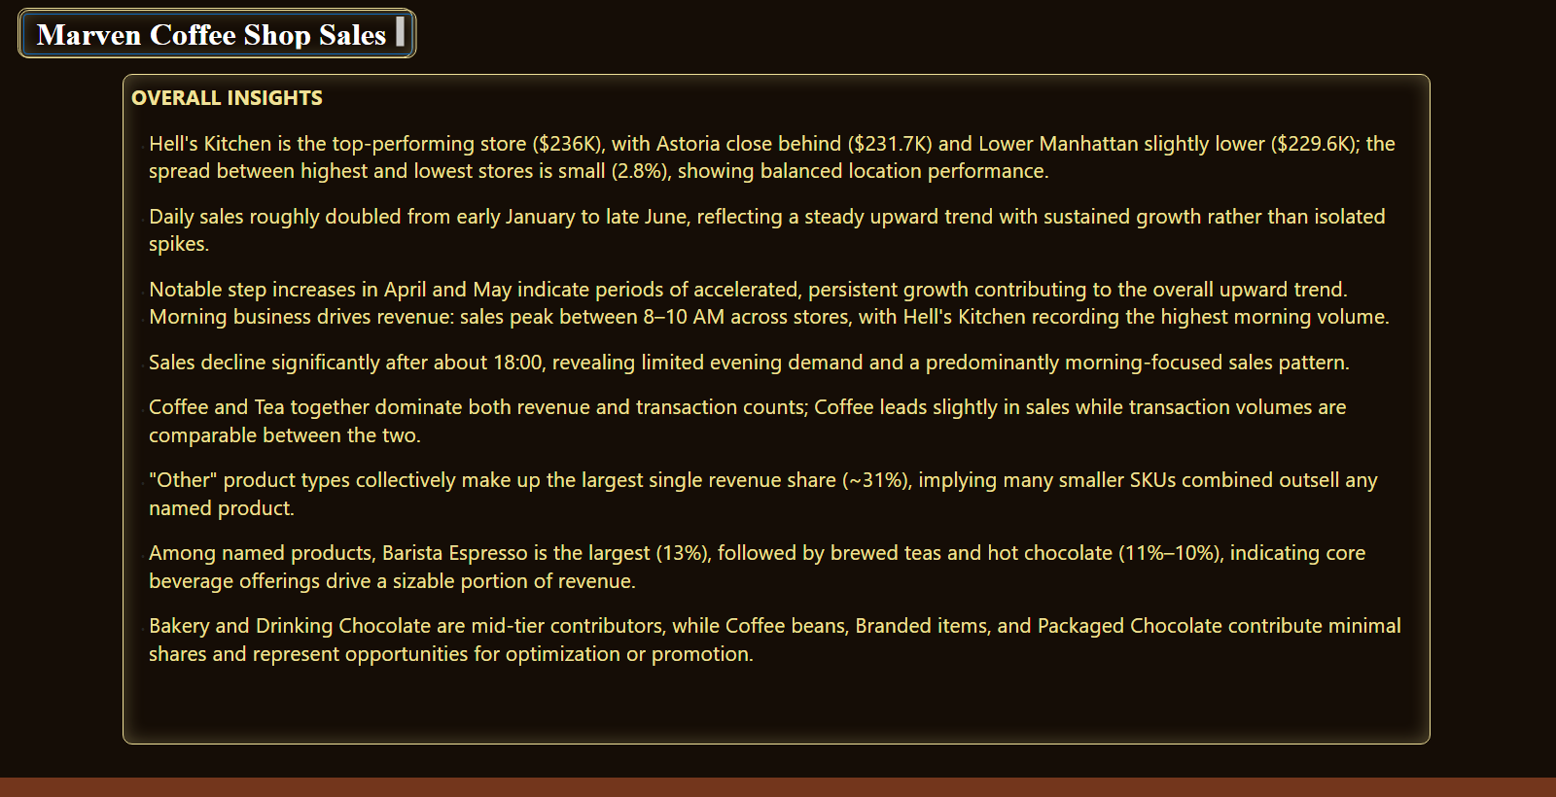
Duplicate of Store location
Notes:
textbox
No alt text provided
shape
No alt text provided
textbox
No alt text provided

